Slide 1

CS-101 PROJECT
Topic : Cryptography Diffie Hellmann Key exchange algorithm
Group Members | Entry Number
SAHARSH SAXENA | 2022csb1116
SAI PRANAV NUTI | 2022csb1117

Slide 2
Motivation And Background
In this digital era security has become of paramount importance. Before Diffie-Hellman Key Exchange was developed many symmetric key algorithms were in use for cryptography, but they faced the major problem of sharing the symmetric key across a public channel(unsafe).
The Diffie-Hellman Key Exchange Algorithm was developed to address this challenge by enabling secure key exchange without requiring shared secret key.
In the early 1970s, Whitfield Diffie and Martin Hellman introduced the concept of public key cryptography. Which has laid a foundation for modern public key cryptography.
Diffie-Hellman was one of the first algorithms which made use of a public key cryptographic system. It introduced the concept of asymmetric encryption, where two different keys, namely the public key and the private key, are used for encryption and decryption. This approach eliminated the need to share secret key, which had been a fundamental requirement in traditional symmetric key algorithms.

Slide 3
Differences between Symmetric And Asymmetric encryption
S.NO | SYMMETRIC ENCRYPTION | ASYMMETRIC ENCYPTION
1) | Single key is used | 2 key are used
2) | Time complexity is less compared to Asymmetric encryption | Time complexity is more compared to Symmetric encryption
3) | Less secure | More secure
4) | Utilizes less resources | Utilizes more resources
5) | It is used in DES & AES Algorithms | It is used in RSA & Diffie Hellman Key exchange Algorithms

Slide 4
Mathematics involved in Diffie Hellman key exchange algorithm
Discrete Logarithms
Example: 26067 = 14^a (mod 29867) ----------(1) x = 14^12(mod 29867) -----------(2) As we observe that calculating the equation (1) is much more tougher than calculating the equation (2), this is an example of one way function.
X = (g ^ n) mod p For calculation n we use the discrete logarithm, n = dlog_{g,p}(x)

Slide 5
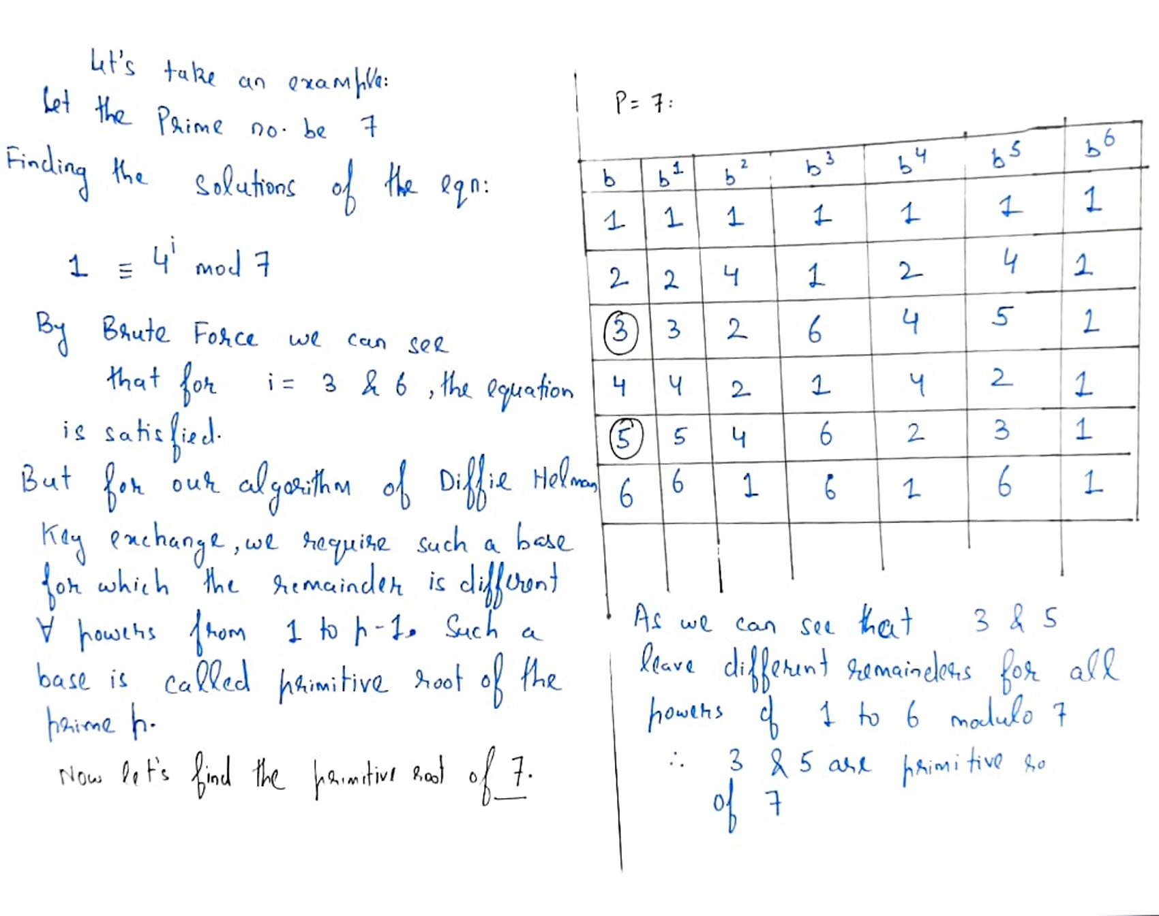
Primitive Root Of A Prime
The primitive root of a prime number p is an integer x in [1,p-1] such that the values of x ^ a(mod p )
Are all different for different values of a ranging from 1 to p-1.

Slide 6
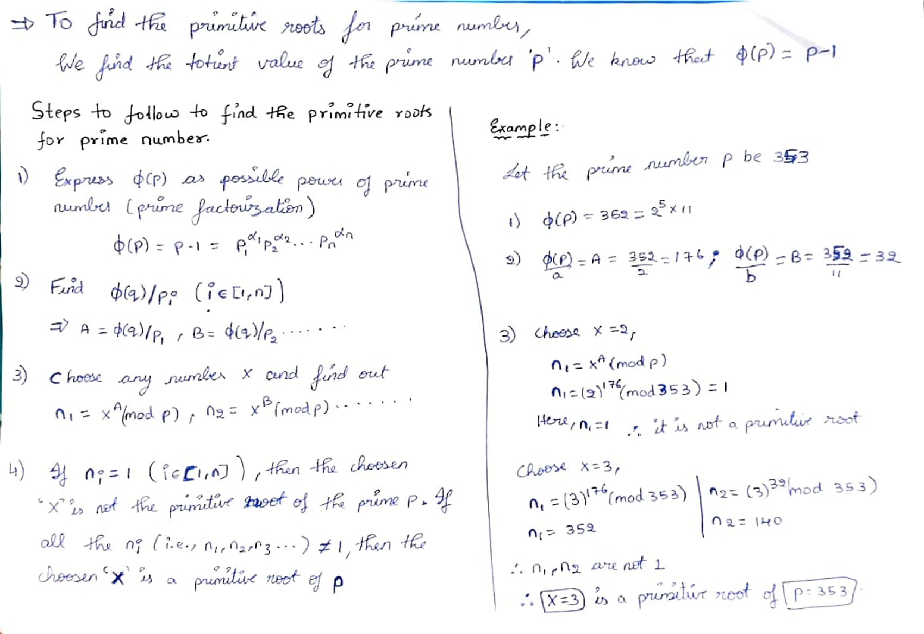
How Do We Find A Primitive Number

Slide 7
Diffie Hellman Key Exchange Algorithm
In Diffie Hellman Key Exchange Algorithm we use two types of keys, namely public and private keys
Public Key : A cryptography which is visible to public domain where any third party member can get to know about the key.
Private Key: A cryptography which remains private to only the user and is not shared to the public domain or visible to third party member.

Slide 8
We choose a prime p and a generator g (here g is the primitive root of p). Both of these have been communicated through the public channel so they are visible in the public world
PERSON A
PERSON B
Xb = 6
B = (g^Xb) mod p
B = (3)^6 (mod 7) B = 1 Now that we know the public key of person A We calculate B₁= (4)^6 (mod 7) B₁= 1
Xa = 4
A = (g^Xa) mod p
A = (3)^4(mod 7) A = 4
Now that we know the public key of person B We calculate, A₁= (1)^4 (mod 7) A₁= 1
B = 1
A = 4
We observe that both A1 and B1 have the same value
Private Channel
Public channel
Private Channel

Slide 9
From the flow chart in previous slide Xa = 4 is the private key of person A and Xb = 6 is the private key of person B .
For the private key Xa we define the public key A as A = (g)^Xa (mod p), similarly we define the public key B = (g)^Xb (mod p) .
Now, these public keys are transferred via an unsafe channel.
So, these A and B are called public keys as they are visible in the public domain.
Though the third party have an account of A and B they cannot calculate the private keys of person A and person B as finding the exponent is a very difficult task for larger values of p, g .
Now the second point is repeated replacing g by B and A while calculating A1 and B1 respectively.
Both get the same value of A1 and B1 after replacing g by B and A in the step 6 which turns out to be the key value of the encrypted message.

Slide 10
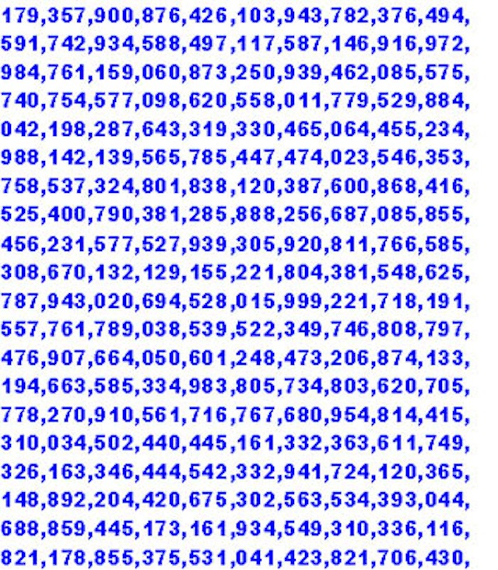
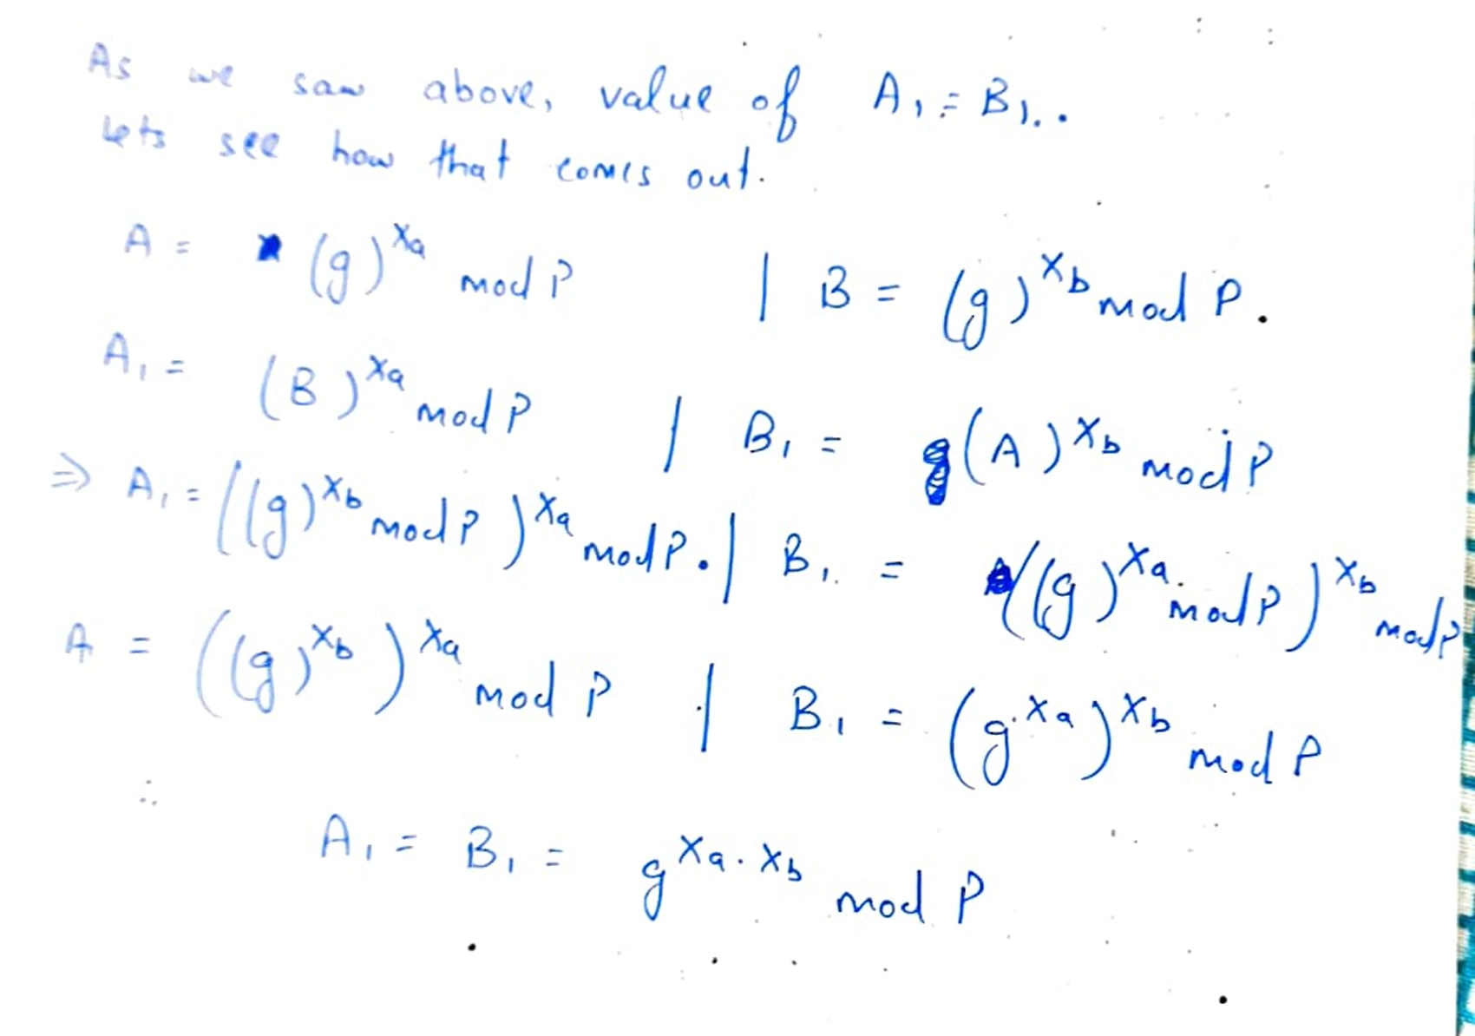
Why A1 = B1? The proof goes as follows
Source : https://www.google.com/url?sa=i&url=https%3A%2F%2Fdavescomputertips.com%2Fgeek-facts-for-august-23rd-a-big-prime-number-and-jaguar%2F&psig=AOvVaw2235tR7bEu74V-Gc-HO1fl&ust=1687376180589000&source=images&cd=vfe&ved=0CBEQjRxqFwoTCND386DM0v8CFQAAAAAdAAAAABAE
Prime numbers of this order are generally used practically

Slide 11
Man In The Middle Attack
3rd party
Af
A
Bf
B
A
Person A
Person B
B
Xa
Xb

